Slide 1

Building a Brand Detection Model with YOLO
Prepared by Mohamed Suhaib

Slide 2
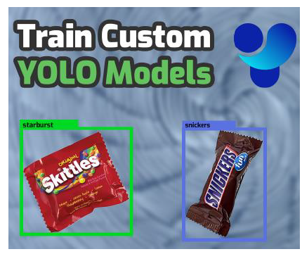
Problem Statement
The goal of this hackathon is to use neural networks, computer vision, YOLO to detect objects. This means you have to use YOLO to identify the objects in the image.

Slide 3
Scope of this project
You’ll be using the chocolate brand Dataset from. The dataset contains 162 pictures of popular candies (Skittles, Snickers, etc.)
Download Link for dataset: Dataset
Download Link for Train-Validation Folder Structure Split : train_val_split.py
(This script needs to executed before the training process starts, you can refer the practical guide)

Slide 4
Data.yaml:
path: /content/datatrain:
train/images
val: validation/images
nc: 11
names:
- MMs_peanut
- MMs_regular
- airheads
- gummy_worms
- milky_way
- nerds- skittles
- snickers
- starbust
- three_musketeers
- twizzlers

Slide 5
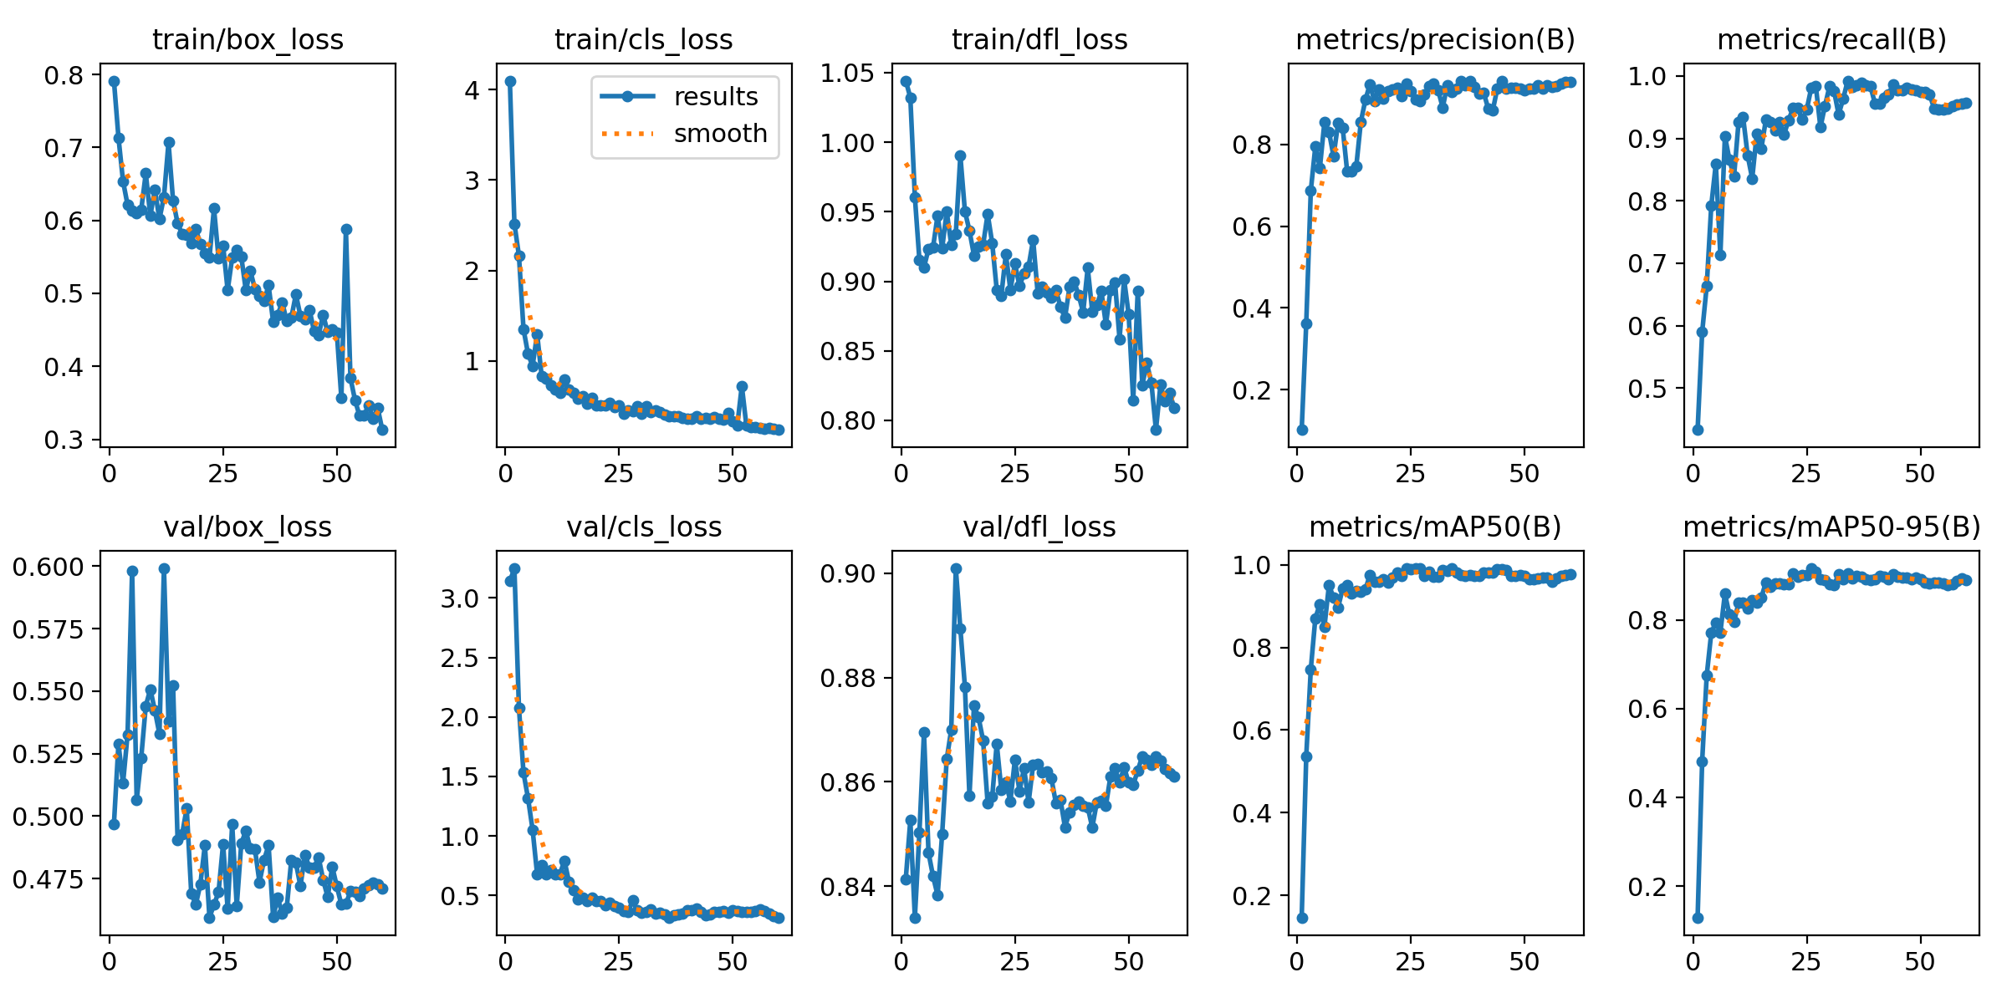
Training and Validation Loss and mAP, Accuracy:

Slide 6
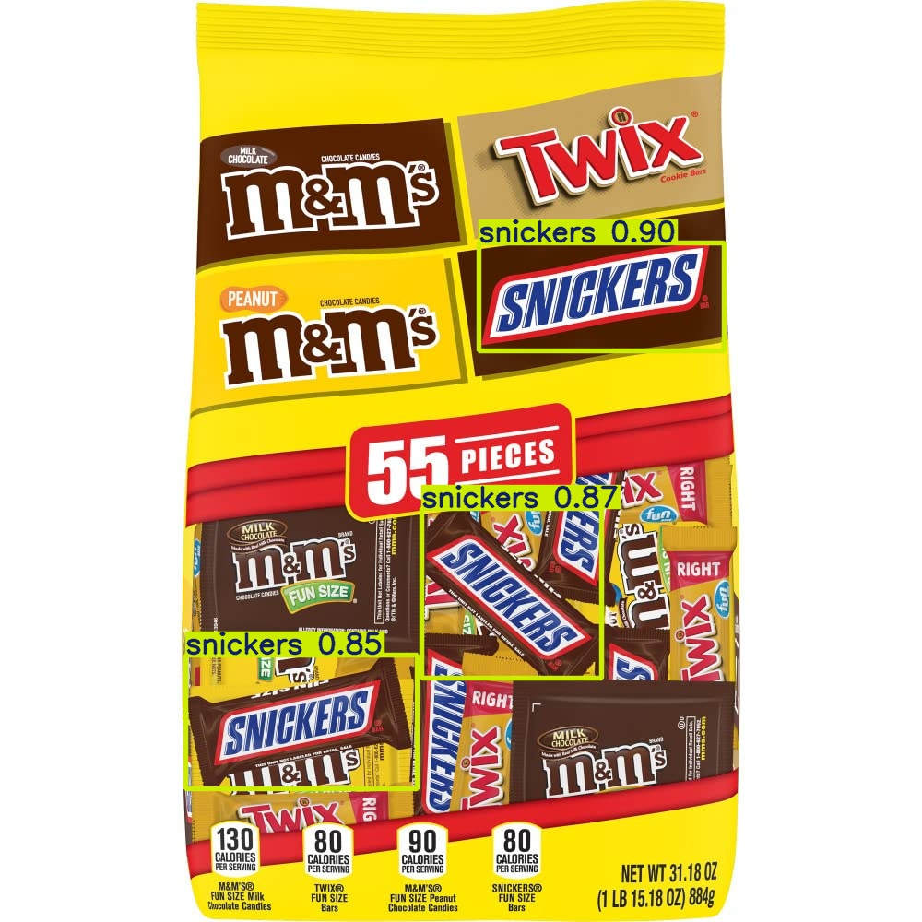
Prediction of Images using Yolo:

